Slide 1
SOFTWARE DESIGN
AND ARCHITECTURE
(SDA)
SESSION 1
UTM KUALA LUMPUR

Slide 2

01
INTRODUCTION
04
SOFTWARE DESIGN
Course Outline and about me.
Challenges and process.
02
INTRODUCTION TO SDA
05
DESIGN FUNDAMENTALS
Hierarchy in design architectural.
Design principle.
03
SDLC RECAP
06
PLANNING
SDLC Process and involvements
Course planning.

Slide 3
Hierarchy in Software Designers
System Engineer / Solution Architect
Software Architect
Software Engineer
UI Designer
Infra / Cloud Architect
Network Engineer

Slide 4
Their Responsibility?
SYSTEMS ENGINEER / SOLUTION ARCHITECT
01
Designs systems using a holistic approach, which includes designing how software, hardware, people, etc. collaborate to achieve the system’s goal.
SOFTWARE ARCHITECT
Design software systems using a black-box modeling approach; concern on the external properties of software components that determine the system’s quality and support the further design of functional requirements.
02
COMPONENT DESIGNER / SOFTWARE ENGINEER
03
Focuses on designing the internal structure and behavior of software components identified during the architecture phase; typically, these designers have strong programming skills, since they implement their designs in code.
USER INTERFACE DESIGNER
Design the software’s user interface; skilled in determining ways that increase the usability of the system.
.
04

Slide 5
Software Development Life Cycle
01.Requirement Analysis
Requirement elicitation and analysis
05.Deployment and Evolution
Deploy, maintenances and feedbacks.
01
02
02.Software Design
Architecture, design and tech stacks.
SDLC
05
04.Testing
Testing and debugging.
03
04
03.Implementation
Development, coding and integrations.

Slide 6
SDLC Involvement
Product Owner
Project Manager
Business Analyst
CTO
Software Architect
Solution Architect
Software Engineer
UI / UX Designer
Front-End Developers
Back-End Developers
Dev Ops
Solution Architect
QA Engineers
Testers
Dev Ops
Users
Support Managers
1
2
3
4
5
Requirement Analysis
Software Design and Architecture
Development and Implementation
Software Testing and
Debugging
Deployment and Evolutions

Slide 7
Common Mistakes to Avoid in SDLC
Client always “right”
Not educating stakeholders
Ambiguous Requirements
Fail timeframe
No risk management
Incomplete design
No architecture framework
Bad task allocations
No team communication
Last minute dev
Small time and budget allocations
No versioning documentation (patch note)
1
2
3
4
5
Requirement Analysis
Software Design and Architecture
Development and Implementation
Software Testing and
Debugging
Deployment and Evolutions

Slide 8
Software Foundation
Why?
To help to accomplish project quickly and efficiently.
To reduce frustrations and confusion along the way.
REQUIREMENTS
DESIGNS
PROCESS AND DOCUMENTATIONS
Always get verification and validation with stakeholders.
Understanding user needs and project requirements.
Importances of detailed designs.
Importances of scalability, performances and maintenance.
Clear and concise process and documentation.
Version control documentation.
8

Slide 9
Software Design Challenges
01. REQUIREMENTS
Requirement volatility
05.MANAGEMENT
Managing design influences.
01
02
02. PROCESSES
Inconsistent development processes.
Most company not well define process
05
03
04.ETHICS
Ethical and professional practices.
Tight schedule, negotiation and motivating
04
03.TECHNOLOGY
Fast, and ever-changing technology.
Co-exist old new tech.

Slide 10

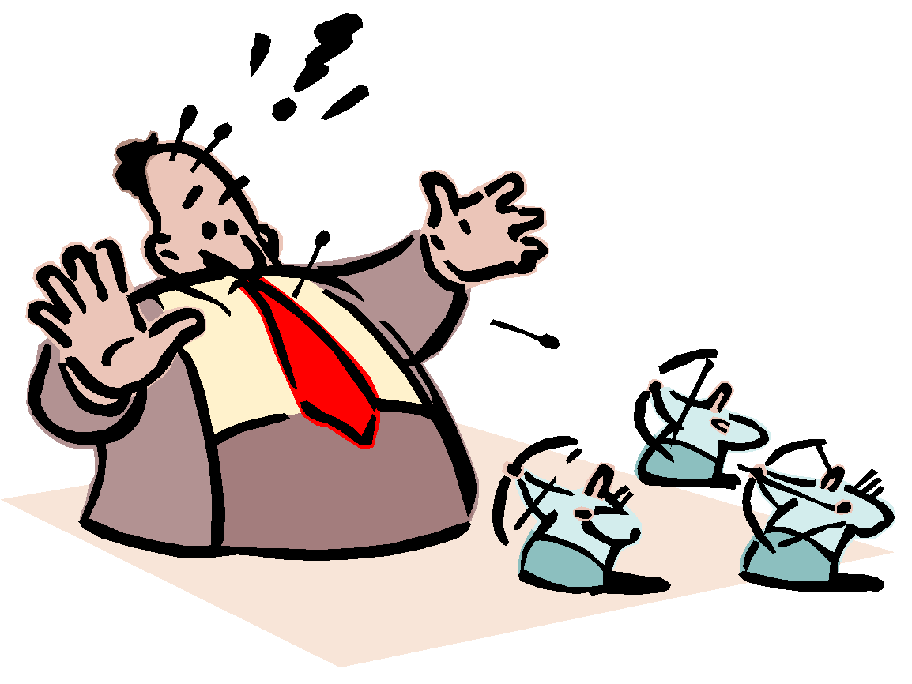



Software Design Challenges
Oops… I don’t remember seeing a requirement for this…
Customers now want a bigger house and more windows by next week!
Must have a strong understanding of the principles of software design and develop skills to manage complexity and change in software projects
There goes my job again!!
I want performance!
I want Usability!
Managing these influences is challenging because it requires designers to span out of the technical domain to have keen interest in the organization as a whole
I want Security!
Yikes!

Slide 11
Software Design Process
Software Architecture
Component Design
Macro design approach for creating models that depict the quality and function of the software system
1
4
Component designs are typically in the form of class diagrams, sequence diagrams, etc
Detailed Design
2
5
Scoping Design
Focuses on functional requirements, whereas the architecture focuses mostly on non-functional, or quality, requirements
Construction design is important to reason, communicate, and document the solution to complex programming problems
3
6
Interface Design
Documentation
Provide a standardized way for accessing services provided by software components
Design documentation must be clear and concise. Then submit to be approved.

Slide 12

PLAN AND SCOPE
5%
58%
Define project goal and objectives
Define priority and scopes
Plan the first prototypes or versions of the project
(atleast cover the business needs).
12%
58%
25%
25%
Functional
Design
12%
5%
Non-Functional
Sustainability

Slide 13
Why need Roadmap?
01
CLEAR OUT THE OUTLINE PRODUCT OR PROJECT
See all the objective.
Effective scheduling.
MANAGEABLE TIMELINE AND COMMUNICATION
02
Help ensure to complete on time.
Effective communications.
03
GET EARLY BUY-IN ON DELIVERABLES
Help in getting clients onboard.
Help in getting more interested investors.
MANAGE EXPECTATION STAKEHOLDERS
Avoid from chaos.
As a reminder, everything in on schedule.
04

Slide 14
Project Roadmap (Lane Departure Warning)
Project phase 1
Project phase 2
Project phase 3
Object detection
Display the view
Improvements
Detect if there is car incoming while departing
Detect and display on car infotainment screen
UI improvements
Response time
Miscellaneous
Completed
Time plan
Time plan
Time plan
30 days
30 days
30 days
Expected results
Expected results
Expected results
Able to detect incoming car
Warning by sound only
Able to display the camera view
Warning by sound and view
Animated UI, etc…
Smooth.

Slide 15
Product Roadmap
1st Version / Generation
May equal to phase 1 or more from project roadmap
Next Version / Generation
Might have similar roadmap with project but with additional features and many other possibilities
Data Collection
Data Mining
Training Model
Project Based
AI Assisted
Automated Departure

Slide 16
Software Design Principle
Modularization
Coupling
Process of continuous decomposition of the software system until fine-grained components are created
1
4
Refers to the manner and degree of interdependence between software modules
Abstraction
Cohesion
While the principle of modularization specifies what needs to be done, the principle of abstraction provides guidance as to how it should be done
2
5
High cohesion good, low cohesion bad
Sufficiency and Completeness
3
6
Encapsulation
Implies minimal interface and general enough for any prospective client
.
Encapsulation provides access only to the necessary data of abstracted entities, no more, no less

Slide 17
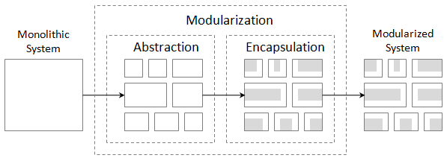
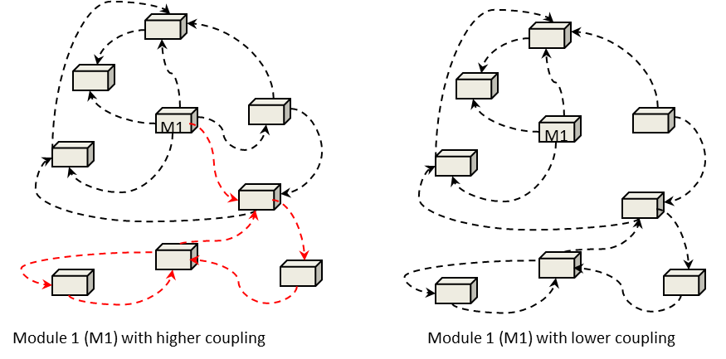
Focus on essential characteristics of entities
Enforce that we only expose essential information

Slide 18
Professionalism
Building a high-performance workforce is essential to achieving success and long-term sustainability in business. But knowing how to look after the qualities of a good and professional employee can increase more the effectiveness and help in internal and external advancement.
COMPETENCIES
HONESTY
COMMUNICATION
RESPECT
Know your job inside out.
Know your responsibility.
Self learning.
Be honest, everyone make mistakes.
Claim what is your rights, not others.
Keep asking if lost.
Watch your language.
Be friendly.
Respect other privacy.
Respect company policy.
Know your and other boundaries.
18

Slide 19

Thank you for your participation. I am very grateful to have the opportunity into this sharing session. If there any enquiries, feels free to contact me.
+013 509 9215
khatibsyarbini@utm.my

Slide 20

THANK YOU
In the Name of God for Mankind
univteknologimalaysia
utm.my
utmofficial

